Slide 1
Instructions!
Please enter your name and department in the chat to receive credit for today’s class.
Thank You!

Slide 2
UCPath Security
User Access Management Process
Training

Slide 3
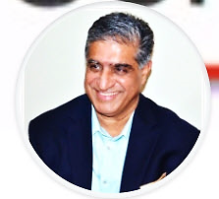
Introductions
Instructor
  Nasser Khan
  UCI UCPath Security Lead
  UCOP-UCPath PMO: 4 years, @ UCI since Jan ‘20
  Over 20 years of Functional PeopleSoft HCM & Security Experience
  Certified Information Systems Auditor (CISA)
  Certified PeopleSoft HCM Consultant
  Security & Risk Management Architect

Slide 4

Course Objectives
Key Objectives:
Understand UCPath Security and Access System
Learn the User Access Onboarding Process
Understand your Roles and Responsibilities
Review use of supporting resources such as Roles Wiki and UCLC

Slide 5
LESSON 1
UCPath Security Primer

Slide 6

Lesson Objectives
1: UCPath Security Primer
3: KSAMS Request & Approval Process
2: UCI UCPath Security
In this lesson, we will:
Learn UCPath security foundational concepts
Understand access implications and dependencies

Slide 7
The Security Duo
Role + Row
Can Perform Work
Role
(Task/Job Role)
Security
(Where)
Row
(Department)
Security
(Who)
Work cannot be performed when only the Role is specified (work/where)
Work cannot be performed when only the Row/Department is specified (who/data)
To Perform Work both the Role and Row must be specified
Notes:
In UCPath security provides granular and configurable access controls.
The two key access permissions that are ‘must-haves’ are Role and Row.
The roles have various access levels to make changes to data, like update or just view information on UCPath online page.
The row level security has granularity down to a department level as to ‘whose’ data a user can see to process.

Slide 8
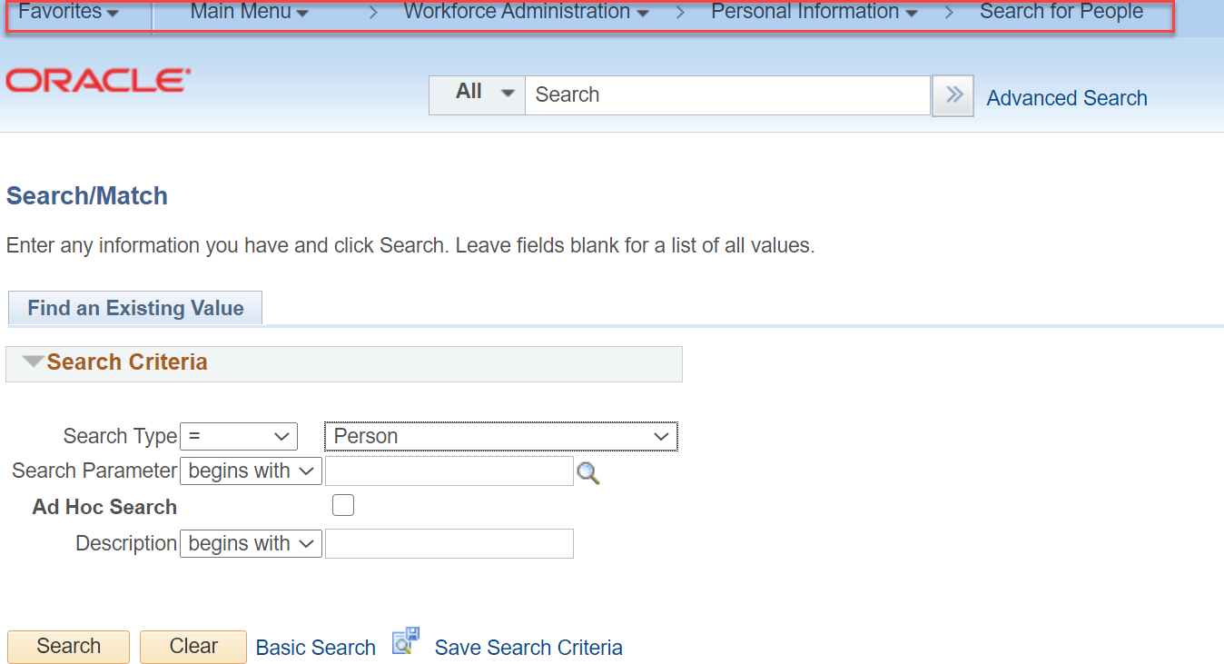
Role for page access
A page role grants access to just the navigation in UCPath

Slide 9


What’s Connected to Row (Department) Level
Persons
  UCPath Online Restricts:
  Who is seen (departments & employees)
  What is visible (data)
Transaction Initiations and Approvals
Job Openings
Notes:
User’s authorization of people and job openings is critical and restricted.
Row level security in UCPath restricts ‘whose’ data you are authorized to see.
Row level security also restricts whose transactions a user can process.
Row level security restricts the business units whose job openings can a user see or process.

Slide 10
What’s Connected to Row (Department) Level
Persons
  Transaction Approval Routing looks at department hierarchy
Organization
Transaction Initiations and Approvals
Division
Sub-division
Department
Job Openings
Notes:
User’s authorization of people and job openings is critical and restricted.
Row level security in UCPath restricts ‘whose’ data you are authorized to see.
Row level security also restricts whose transactions a user can process.
Row level security restricts the business units whose job openings can a user see or process.

Slide 11


What’s Connected to Row (Department) Level
Persons
Transaction Initiations and Approvals
  Job Openings at Campus, Medical Center, or both business units
Job Openings
Notes:
User’s authorization of people and job openings is critical and restricted.
Row level security in UCPath restricts ‘whose’ data you are authorized to see.
Row level security also restricts whose transactions a user can process.
Row level security restricts the business units whose job openings can a user see or process.

Slide 12
Self-Service Access is assigned automatically
Personal
Benefits
Pay
Manager Work
Notes:
All of this access is automatically assigned based on: if you are just an employee or a manager with direct reports.
A self-service user accesses UCPath to see only their own information, gets the access given automatically.
If you have direct reports, you are also automatically able to see the information of your direct reports.
This course is not intended to cover self-service access but to cover the elevated access for transactions and reporting which requires a process of review and approval to be enforced.

Slide 13
Transactional access needs to be requested
Hire
Rehire
Retire
Term
PayPath
Recruiting
Can Only View & Process
Employees Authorized
Initiators &
Approvers
Absences
Submit Request
Forms
Lookup
Job Info
Funding
Reports
Notes:
To gain elevated access to various transactions in a variety of functional areas, access needs to be requested through the KSAMS system.
Approved users process transactions for the functions they are approved for, and the people they are approved for.
This elevated access is divided in KSAMS roles by functional area. The level of access varies based on user’s job duties, business roles, and tasks they are expected to perform.
Transaction roles are two kinds primarily
Initiators: Start a transaction, such as hire an employee.
Approvers: Approve that transaction.

Slide 14
LESSON 2
UCPath Security @UCI

Slide 15
Lesson Objectives
1: UCPath Security Primer
3: KSAMS Request & Approval Process
2: UCI UCPath Security
In this lesson, we will:
How users are grouped
Understand the types of roles we have with the intended user groups
User role assignment considerations & guidelines

Slide 16
User Group Examples
Grad. Div.
Advancement
Research
Schools
Med Center
College of Health Sciences
UCPath Admins
Cont.
Ed.
Campus Central
Campus Transactor
DFA
Student Affairs
OIT
Notes:
Users groups are either central or at department/division/school/identified staff, such as Academic, level etc.
Across UCI, UCPath roles are grouped into groups of department and centralized user groups.
KSAMS roles names broadly map to these user groups.
Then the users are grouped by functional area as well as a second layer of refinement. Such as Payroll and HR.
Some functional areas are centralized whereas some HR/TAM/ePerformance are on a distributed processing model.

Slide 17
Transactor Roles-By Functional Area
Mini 1
Mini 1
AWE
Transaction Approver
Workforce Administration
Payroll
TAM
General Ledger
Candidate Mgt
Applicant Mgt
Job Opening
Job Offer
TAM Approver
Prepare for Hire
GL Cost Transfer
GL Funding Entry
Payroll
Workforce Administration
Transaction Initiator
Notes:
Provide pop txn names behind each of the box

Slide 18
Transactor Roles-By Functional Area
Transactor Roles-By Functional Area
Transaction Initiator
Workforce Administration
Payroll
AWE
Transaction Approver
Workforce Administration
Payroll
TAM
GL Funding Entry
GL Cost Transfer
General Ledger
Candidate Mgt
Applicant Mgt
Job Opening
Job Offer
TAM Approver
Prepare for Hire
AWE
Transaction Approver
Workforce Administration
Payroll
TAM
General Ledger
Candidate Mgt
Applicant Mgt
Job Opening
Job Offer
TAM Approver
Prepare for Hire
GL Cost Transfer
GL Funding Entry
Payroll
Workforce Administration
Transaction Initiator
Smart HR Templates
Additional Pay Request
Add funding to positions
Salary Cost Transfer to different funding
Transaction Initiator
Workforce Administration
Payroll
AWE
Transaction Approver
Workforce Administration
Payroll
TAM
GL Funding Entry
GL Cost Transfer
General Ledger
Candidate Mgt
Applicant Mgt
Job Opening
Job Offer
TAM Approver
Prepare for Hire
Notes:
Provide pop txn names behind each of the box

Slide 19
Transactor Roles-By Functional Area
Approve hire of employees or CWR
Approve a pay request
Approve funding changes
Transaction Initiator
Workforce Administration
Payroll
AWE
Transaction Approver
Workforce Administration
Payroll
TAM
GL Funding Entry
GL Cost Transfer
General Ledger
Candidate Mgt
Applicant Mgt
Job Opening
Job Offer
TAM Approver
Prepare for Hire
Notes:
Provide pop txn names behind each of the box

Slide 20
Transactor Roles-By Functional Area
Manage a candidate
Manage data of a job applicant
Create or change a Job Opening/Posing
Make a Job Offer
Approve offers to be made
Transaction Initiator
Workforce Administration
Payroll
AWE
Transaction Approver
Workforce Administration
Payroll
TAM
GL Funding Entry
GL Cost Transfer
General Ledger
Candidate Mgt
Applicant Mgt
Job Opening
Job Offer
TAM Approver
Prepare for Hire
Prepare applicant for Hire
Notes:
Provide pop txn names behind each of the box

Slide 21
Inquiry Roles
Absence Management
Absence Management
Person Organization Summary
I-9 Reviewer
Payroll
Payroll
Contract Pay
Workforce Summary
Person Checklist
General Ledger
Budget
Direct Retro
Funding
BCT
WorkStudy
Workforce Administration
External Systems ID
Talent Acquisition Management
Print Apps
BN HCF
Notes:
Acronyms have been defined in training the user takes.

Slide 22
Inquiry Roles
Inquiry Roles
Absence Management
Absence Management
Absence Management
Person Organization Summary
I-9 Reviewer
Payroll
Payroll
Contract Pay
Workforce Summary
Person Checklist
General Ledger
Budget
Direct Retro
Funding
BCT
WorkStudy
Workforce Administration
External Systems ID
Talent Acquisition Management
Print Apps
BN HCF
Review
Absence
History
Absence Management
Absence Management
Person Organization Summary
I-9 Reviewer
Payroll
Payroll
Contract Pay
Workforce Summary
Person Checklist
General Ledger
Budget
Direct Retro
Funding
BCT
WorkStudy
Workforce Administration
External Systems ID
Talent Acquisition Management
Print Apps
BN HCF
Notes:
Acronyms have been defined in training the user takes.

Slide 23
Inquiry Roles
Inquiry Roles
Workforce Administration
Review
Person’s Job Info
Review
I-9 Work Eligibility
See Where
Employee Works
Absence Management
Absence Management
Person Organization Summary
I-9 Reviewer
Payroll
Payroll
Contract Pay
Workforce Summary
Person Checklist
General Ledger
Budget
Direct Retro
Funding
BCT
WorkStudy
Workforce Administration
External Systems ID
Talent Acquisition Management
Print Apps
BN HCF
Crosswalk of Old Employee Numbers
Notes:
Acronyms have been defined in training the user takes.

Slide 24
Inquiry Roles
Inquiry Roles
Payroll
Review Employee’s Pay or Deductions
Review
Contract Pay
Perform Health Care Facilitator Review
Absence Management
Absence Management
Person Organization Summary
I-9 Reviewer
Payroll
Payroll
Contract Pay
Workforce Summary
Person Checklist
General Ledger
Budget
Direct Retro
Funding
BCT
WorkStudy
Workforce Administration
External Systems ID
Talent Acquisition Management
Print Apps
BN HCF
Notes:
Acronyms have been defined in training the user takes.

Slide 25
Inquiry Roles
Inquiry Roles
General Ledger
Review
Position Budgets
Review Retro Salary Cost Transfers
Review
Funding Sources
Review Benefits
Cost History
Absence Management
Absence Management
Person Organization Summary
I-9 Reviewer
Payroll
Payroll
Contract Pay
Workforce Summary
Person Checklist
General Ledger
Budget
Direct Retro
Funding
BCT
WorkStudy
Workforce Administration
External Systems ID
Talent Acquisition Management
Print Apps
BN HCF
Review Graduate
Work Study
Notes:
Acronyms have been defined in training the user takes.

Slide 26
LESSON 3
KSAMS Request & Approval Process

Slide 27
Lesson Objectives
1: UCPath Security Primer
3: KSAMS Request & Approval Process
2: UCI UCPath Security
In this lesson, we will:
Understand different types of UCPath role requests
Overview of access onboarding process
Understanding of the information the process participants are expected to review when approving a request
Resources to validate requests-Demo walkthrough
A walkthrough of the Security websites-Roles Wiki

Slide 28
Participants of User Access Process
Immediate Supervisor is Responsible for Access
Request
DSA
KSAMS
UCPath
Security
Admin

Slide 29
Participants of User Access Process
Supervisor
DSA
Reviews Request for Training & Compliance
KSAMS
UCPath
Security
Admin

Slide 30
Participants of User Access Process
Supervisor
DSA
UCPath
Security
Admin Reviews
Process Compliance
KSAMS

Slide 31
Participants of User Access Process
Supervisor
DSA
KSAMS
Record of Approval
UCPath
Security
Admin

Slide 32



User Access Approval Process
Supervisor
DSA
What roles are needed per Roles Wiki?
Cleanup old access
in KSAMS &
confirm training
User
Training Check
UCPath Security
Hire,
Transfer or
Promotion
Has user completed training for roles?
Request compliant with user’s job and role’s training requirements? Approve or pushback

Slide 33
Note that…
First Level approver is DSA
Second Level approval is required for all Initiator and Approver roles-UCPath Sec Admins
Inquiry Only roles do not require Second Level approval
Roles are provisioned in UCPath in almost real time after successful final approval.
A DSA typically cannot make requests for access outside of their department
  Access outside of a person’s department must be requested by the outside department
When a user transfers to another job, old access is not removed automatically. Its only when a user is terminated, access is removed automatically
KSAMS role of ‘HR Departmental DSA’ is reviewed approved by UCPath Security Administrator
Notes:
All approvals do not follow the same path.
Coordinate with previous DSA and get approval from current supervisor if previous role and row security must stay, else request removal. DSA needs to track transfers out as being trigger to remove access they approved.

Slide 34
Training Compliance Check
Requirement
User is responsible to complete training, when required, for the role’s assignment
Verification
User having completed training is to be verified by user’s immediate supervisor before submitting the KSAMS request
Roles identified
Roles that require training have this identified in the name of the role in KSAMS by suffix “(Requires Training)”
Where to find
Curricula is posted on Roles Wiki
Notes:
Training compliance is one key control activity being introduced.

Slide 35
Training Compliance Check
Requirement
User is responsible to complete training, when required, for the role’s assignment
Verification
User having completed training is to be verified by user’s immediate supervisor before submitting the KSAMS request
Roles identified
Roles that require training have this identified in the name of the role in KSAMS by suffix “(Requires Training)”
Where to find
Curricula is posted on Roles Wiki
Notes:
Training compliance is one key control activity being introduced.

Slide 36
Training Compliance Check
Requirement
User is responsible to complete training, when required, for the role’s assignment
Verification
User having completed training is to be verified by user’s immediate supervisor before submitting the KSAMS request
Roles identified
Roles that require training have this identified in the name of the role in KSAMS by suffix “(Requires Training)”
Where to find
Curricula is posted on Roles Wiki
Notes:
Training compliance is one key control activity being introduced.

Slide 37
Training Compliance Check
Requirement
User is responsible to complete training, when required, for the role’s assignment
Verification
User having completed training is to be verified by user’s immediate supervisor before submitting the KSAMS request
Roles identified
Roles that require training have this identified in the name of the role in KSAMS by suffix “(Requires Training)”
Where to find
Curricula is posted on Roles Wiki
Notes:
Training compliance is one key control activity being introduced.

Slide 38
Steps to request approval
Navigate to UCI UCPath Page
Quicklinks to Roles Wiki
Request in KSAMS
Determine Access Needs
Visit UCPath Website
Determine appropriate Roles
Review Roles Wiki
KSAMS
Submit Request
Notes:
Understand the risks and requirements for the roles
Validate ‘training’ and ‘role appropriateness’ compliance when reviewing the Roles Wiki
Understand how to submit KSAMS requests

Slide 39
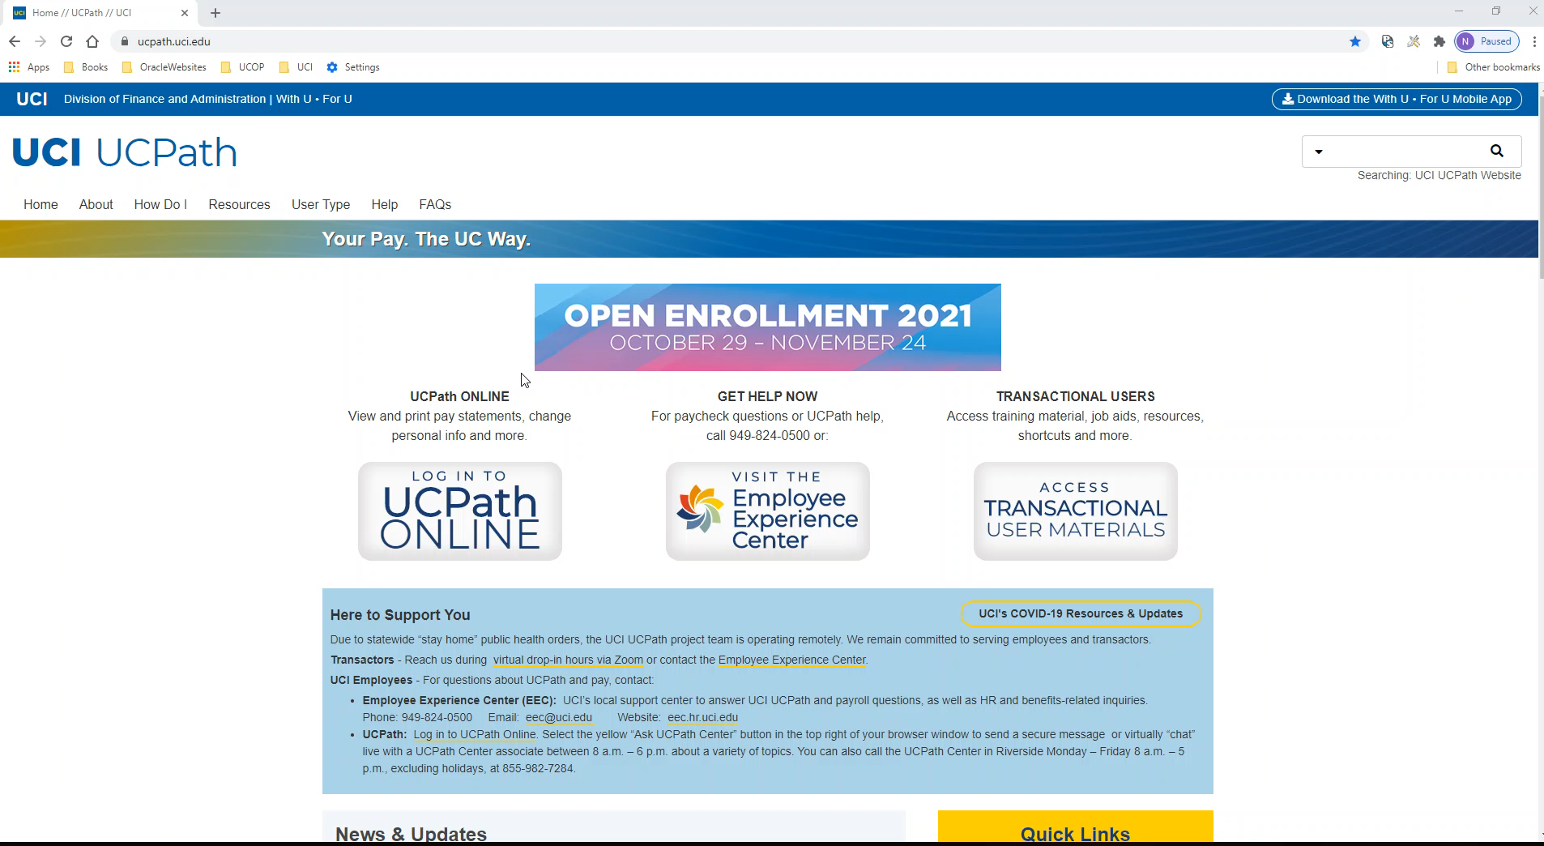
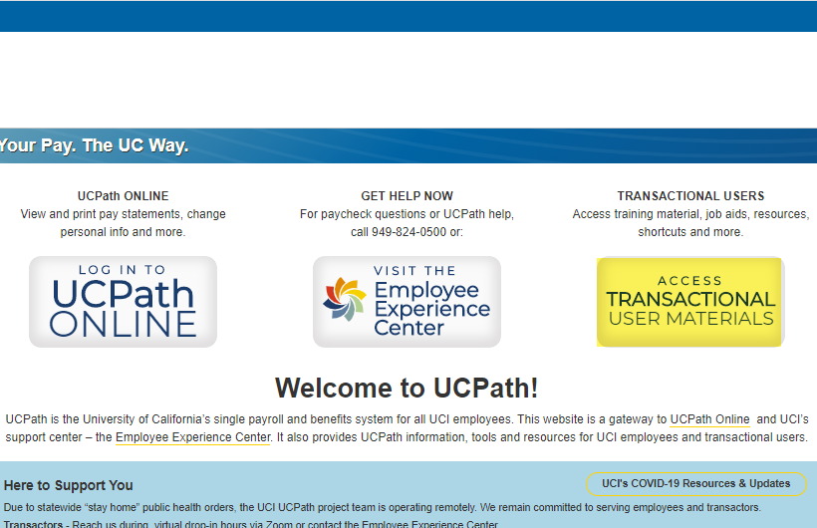
Referencing Roles Wiki
Online Demo of steps

Slide 40
Roles & Responsibilities
Supervisor reviews if user/direct report has completed training for the role being requested and record it in KSAMS request. DSA confirms.
DSA Adjusts security access (as applicable) after a Job Data Change associated with a Hire, Rehire, or Transfer has taken effect. BPG WFA.54
DSA maintains list of departmental Initiators and Approvers for the campus roles assigned to users in their group.
Notes:
DSA is the first level of approval.
UCPath Security Admin will be second and final level of approval for all initiator and approver roles.
Inquiry(view) only access will only require DSA approval.
Anyone requesting access to departments outside their own Division, the KSAMS request will be routed to the DSA responsible for that Division.
Use judgement. See if request makes sense!
Show process.

Slide 41
Roles & Responsibilities (Appropriateness)
Supervisors and DSA review that the role is appropriate for the requestors job.
  Examples:
    User works in Accounting Office as a financial analyst and is requesting Hire role.
    User is not authorized or is delegated to approve transactions and is requesting an approver role
    User is requesting Department Row Level security for employees of another division when they are not expected to view or process transactions for those employees.
    User is requesting a transaction initiator role.
    User is requesting a role that would show sensitive or PII (Personally Identifiable Information such SSN/DoB/Home address/Beneficiary data) when it is not users job to work with PII data.
Notes:
DSA is the first level of approval.
UCPath Security Admin will be second and final level of approval for all initiator and approver roles.
Inquiry(view) only access will only require DSA approval.
Anyone requesting access to departments outside their own Division, the KSAMS request will be routed to the DSA responsible for that Division.
Use judgement. See if request makes sense!
Show process.

Slide 42
Summing Up
Checks | Record of Check | Recommended Record of Validation
Training | Capture in KSAMS request in the “Justification/ Reason” entry box | Supervisor or user checks for Transcript Record in UCLC
Appropriateness | Reviewed Roles Wiki access appropriateness | Exchange of emails between approving DSA and the user’s current immediate supervisor, for example, stating that the roles are required to perform the work the user has been assigned.
Employment Status | Per Org Summary | DSA checks user’s department, Jobcode, employee class, level etc.
Transfer Alert | Job, Position, Department, Division | Ensure access is still valid. Remove access.
Periodic Review | Demonstrate action taken on KSAMS Audit Reports | *User Access Appropriateness Certification-UCPath process under development
*User Access Appropriateness certification to be rolled out in 2021
Notes:
Read the slide.

Slide 43
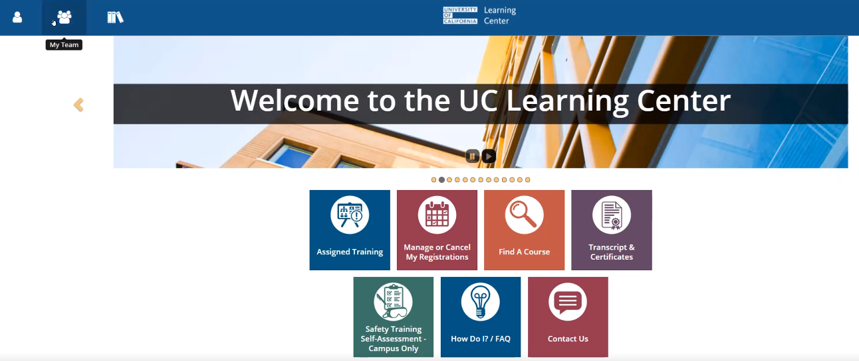

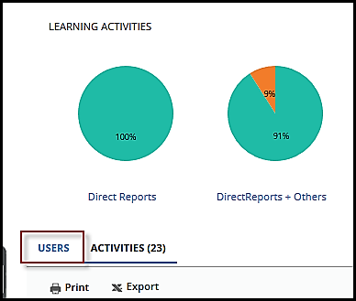
Checking Direct Report’s Training in UCLC
JobAid
Supervisors can review training of their direct reports.
Login to UCLC.
Click the My Team icon on the top left (it's the one in the middle).
Click on Manager Dashboard.
In the section that opens, there is a section to view activities or users, click Users.
1
2
3

Slide 44
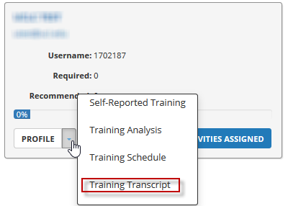
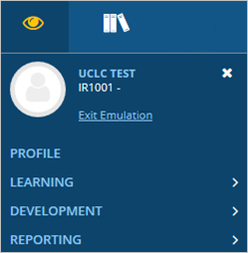
Checking Direct Report’s Training in UCLC (cont.)
JobAid
Click the Profile drop-down arrow and select Training Transcript.
  Caution: You are now emulating the employee, i.e. accessing the employee’s training profile as if you are signed in as the employee. Any changes you make will become part of the employee’s record.
To stop emulating the employee and return to your own account, click the eyeball. Select Exit Emulation.
4
5

Slide 45
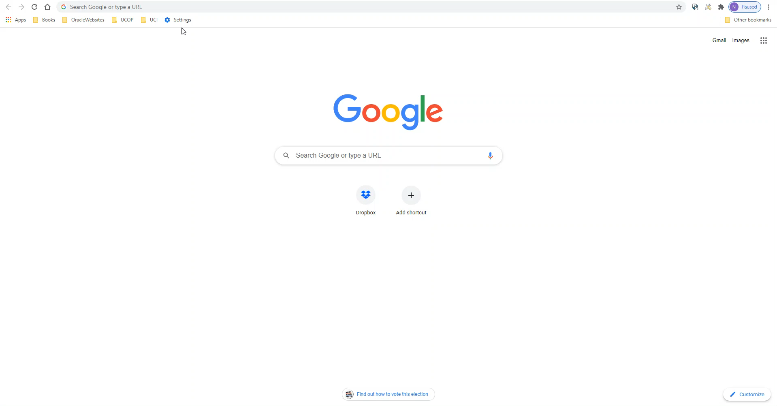
Request in KSAMS
Verify the UCINet ID with department, position, and other ways
Namespace is UCPATH for the role
Role Name starts with UCP-Campus
HR Department not KFS Org
Notes:
Verify the UCINet ID with department, position, and other ways
Namespace is UCPATH for the role
Role Name starts with UCP-Campus
For Department Level Security, make sure you pick HR Department not KFS Org

Slide 46
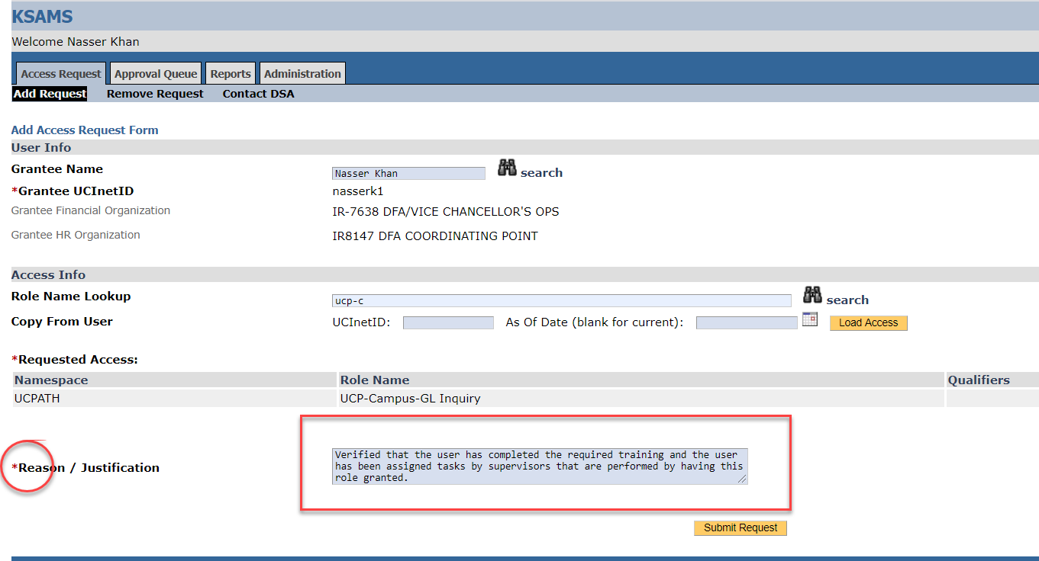
Record of Training
Security Admin’s approval basis is actions and record of the actions.
It’s a required field
Notes:
DSA has verified that the user has completed the required training and the user has been assigned tasks by supervisors that need to be performed with this/these role/s.

Slide 47
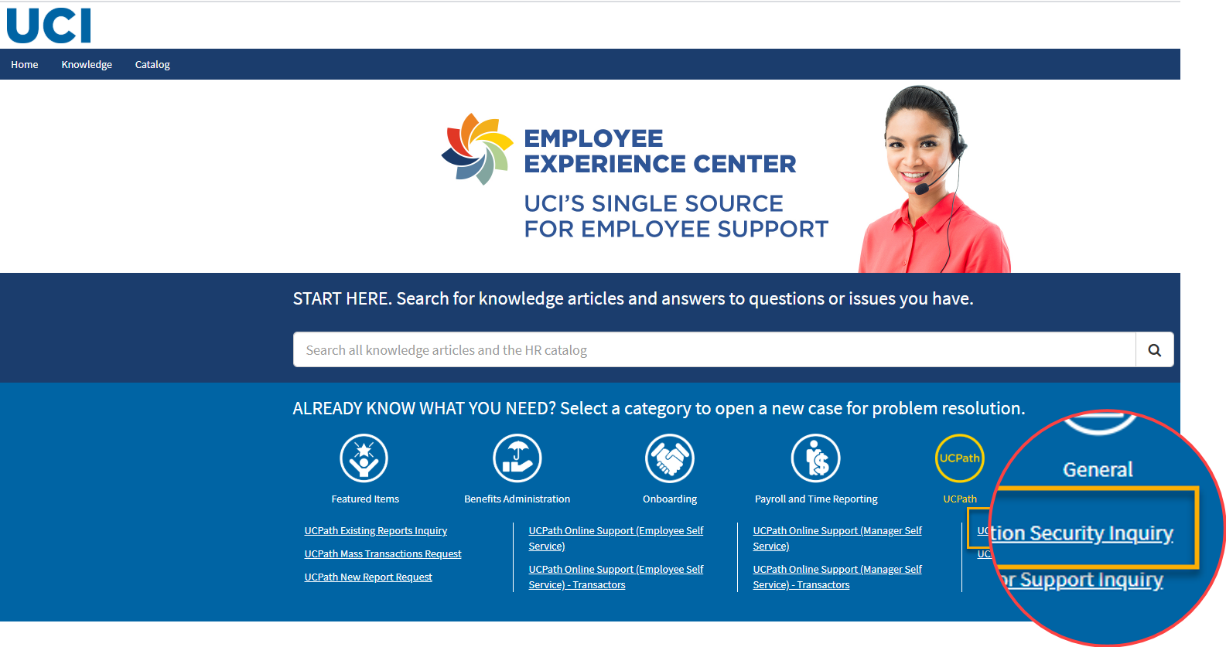
Thank You!
Useful links:
  UCPath System Access Resources (https://ucpath.uci.edu/security)
  Roles Wiki (https://wiki.oit.uci.edu/display/PPSHRISPUB/UCPath+Roles+Wiki)
  UC Learning Center (https://uclc.uci.edu/)
  KSAMS OIT Guide (https://www.oit.uci.edu/help/ksams/)
  KSAMS Requests (https://systems.oit.uci.edu/kfs/ksams/)
  Open a Security Inquiry with EEC for questions
    UCI UCPath Security administration (101 Academy)
    Nasser Khan (949 824-6424) Nasser.Khan@uci.edu
    Anthony Nguyen (949 824-5971) AnthonyLuan.Nguyen@uci.edu

